Slide 1
AN INTERNATIONAL HORS D'OEUVRE EXPERIENCE
Southern Soul
Global Palate
Where Southern roots meet the traditions of the world.
HL CATERING

Slide 2
THE CONCEPT
One pantry, five traditions,
a single point of view.
01
02
03
Southern Roots
International Forms
One Refined Bite
We begin with the soul of Southern cooking — Carolina Gold rice, collard greens, andouille. Ingredients with deep provenance and unmistakable character.
We borrow the world's own forms and flavors — Hawaiian musubi, Nigerian suya, Vietnamese green chili, Italian arancini, Ukrainian borscht — each carrying that Southern character.
The result is a single hors d'oeuvre: familiar enough to comfort, precise enough to hold its own at any international table.

Slide 3
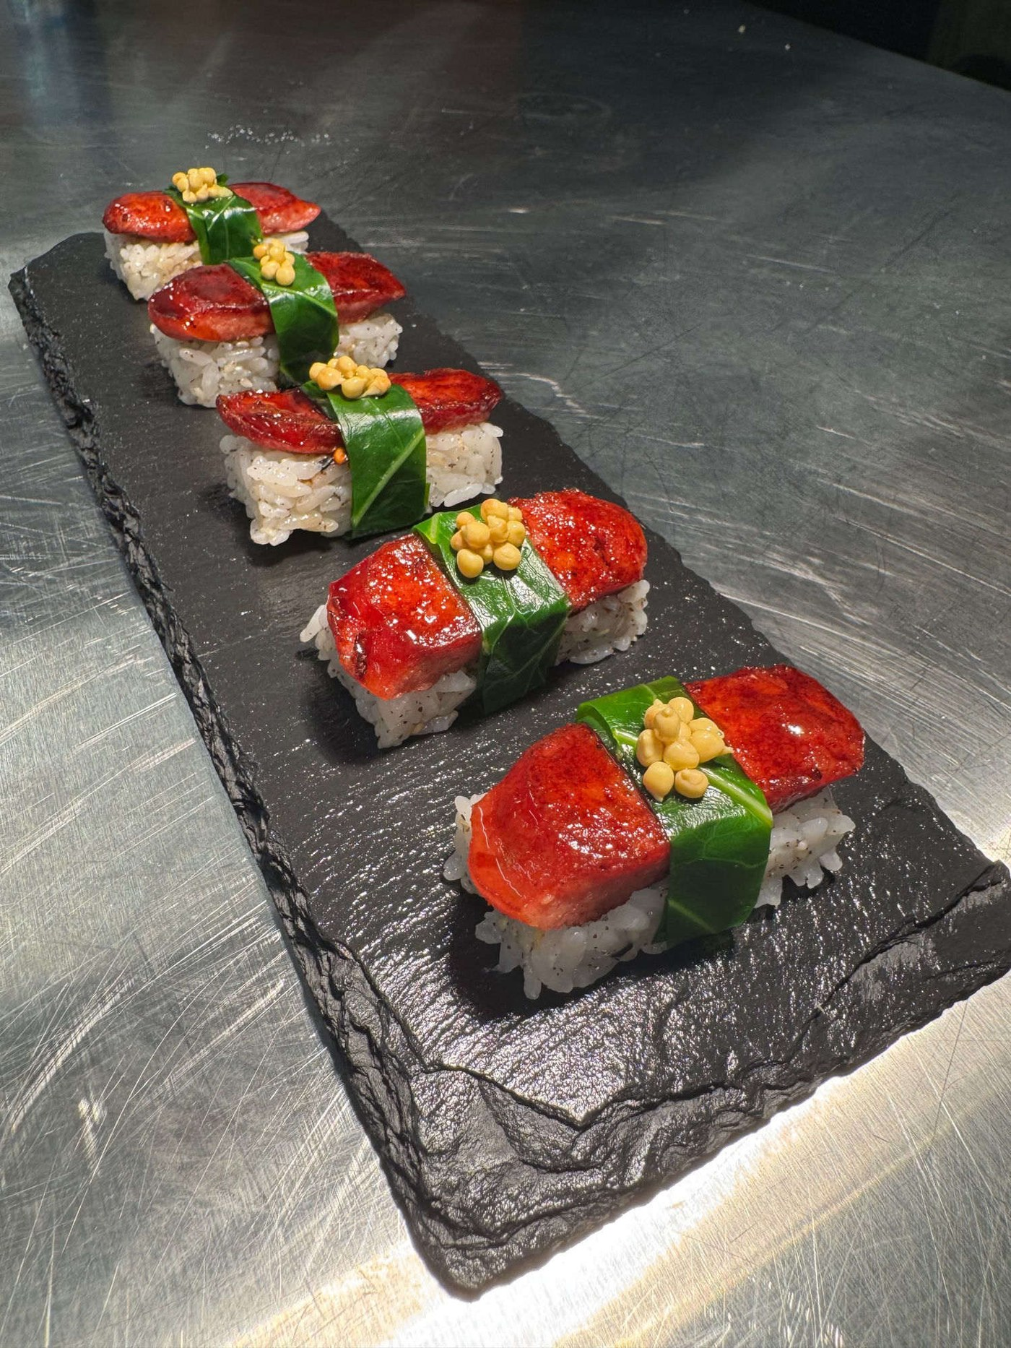
01
Carolina Gold
Musubi
Where the South meets the Pacific.
ORIGIN Southern / Hawaiian FORMAT Musubi
Hawaiian musubi, rebuilt from the Southern pantry — collard for nori, andouille for spam.

Slide 4
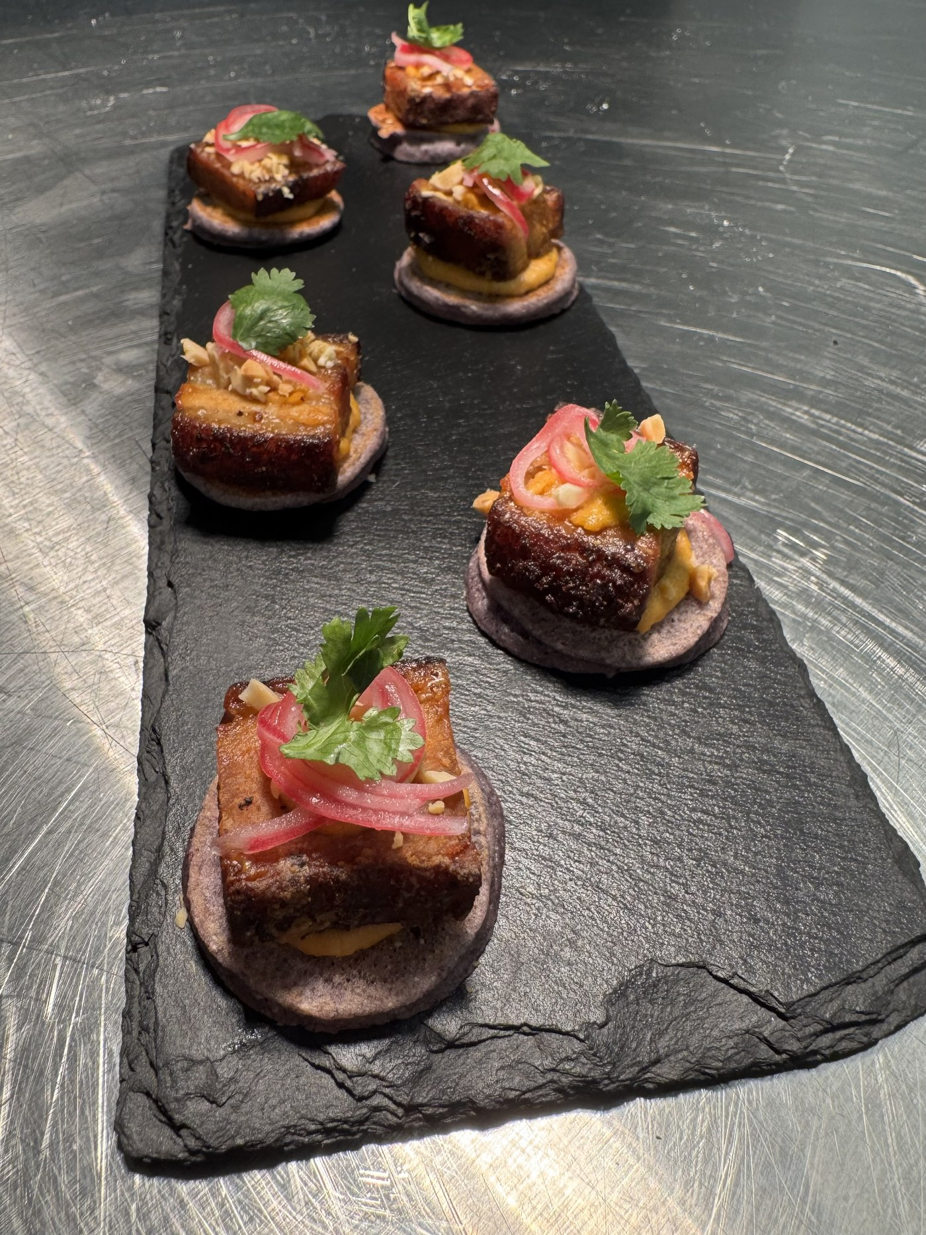
02
Suya Pork
Hoe Cake
Nigerian suya spice meets the Southern hoe cake.
ORIGIN Southern / West African FORMAT Hoe Cake
Pork in yaji — the peanut-and-chili suya spice — seared and set on a griddled cornmeal hoe cake.

Slide 5
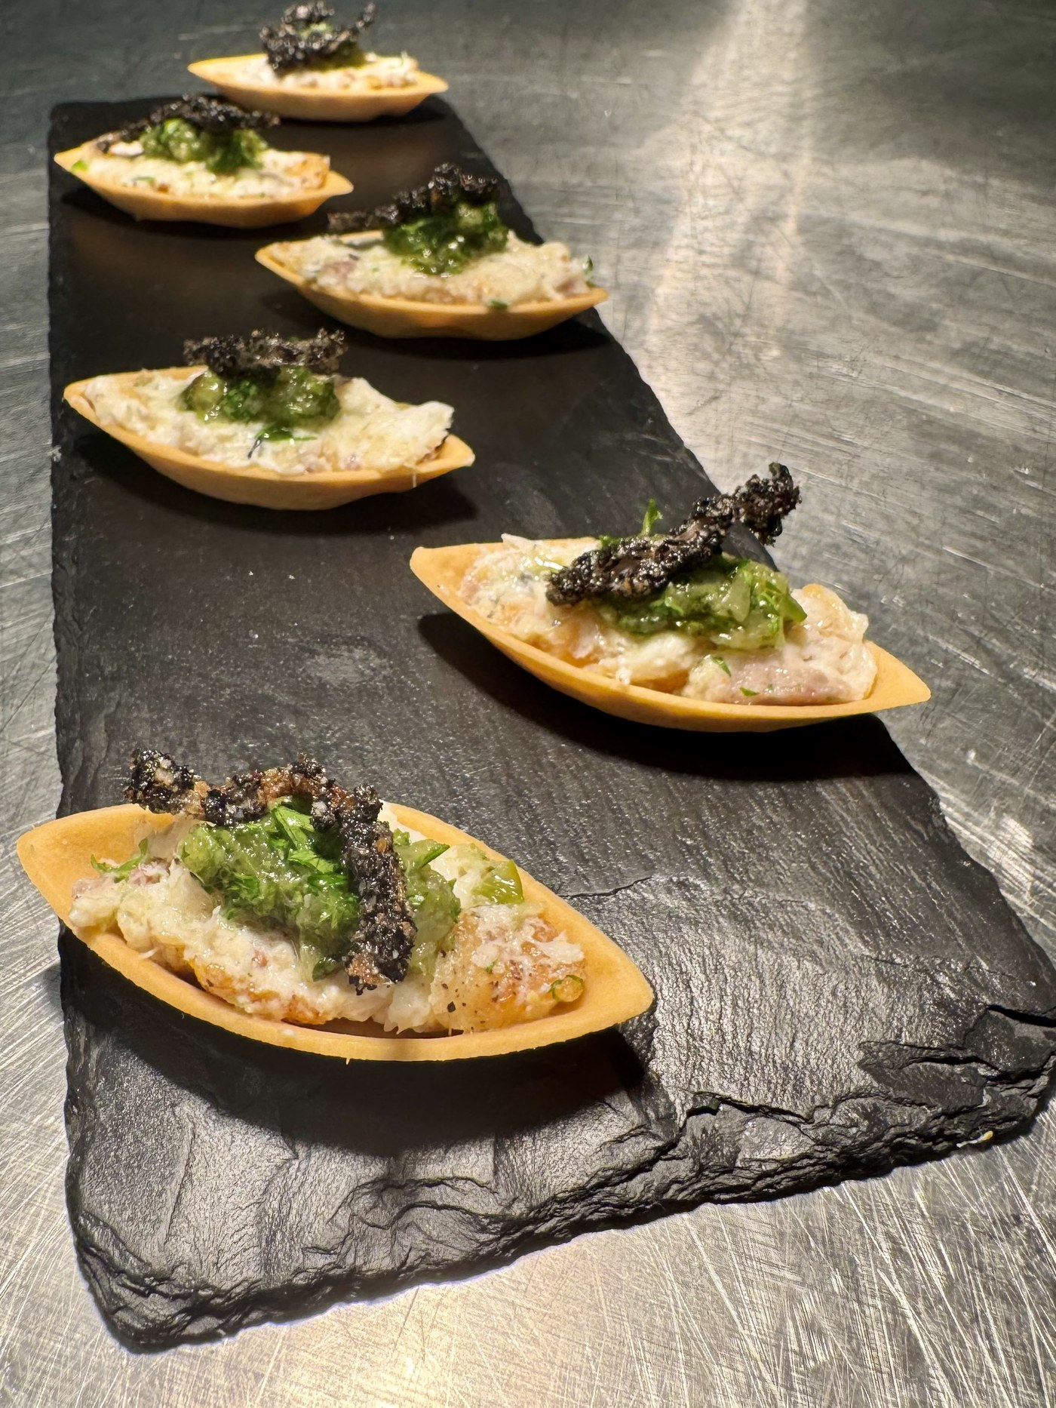
03
Smoked Catfish
Rillette
Smoked Southern catfish meets Vietnamese green chili.
ORIGIN Southern / Vietnamese FORMAT Tartlet
Rich smoked-catfish rillette, cool and creamy — topped with a sesame-crusted fried shallot and a sharp green chili sauce.

Slide 6
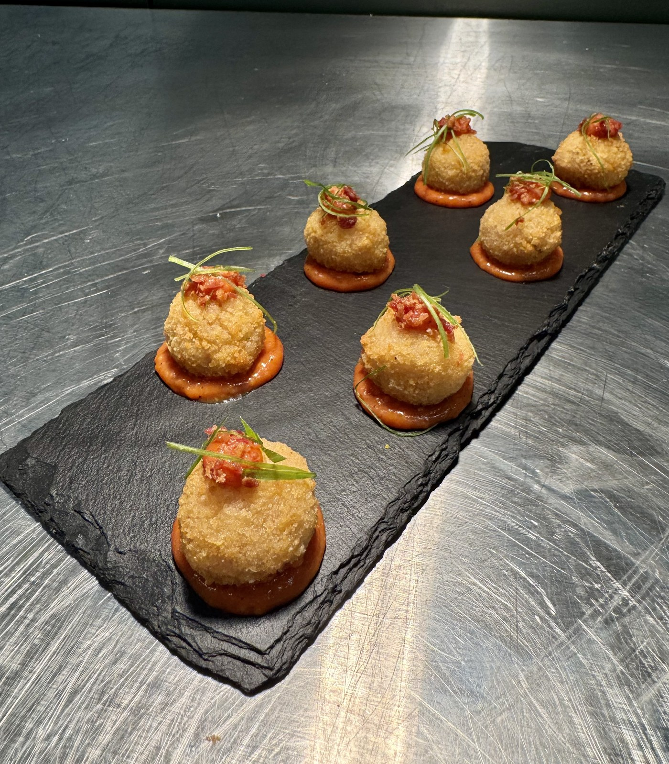
04
Grits Arancini
with Pimento Cheese & Country Ham
Italian technique, Southern grits — one crisp bite.
ORIGIN Southern / Italian FORMAT Arancini
Crisp grits shell stuffed with pimento cheese and country ham — over a pool of train wreck sauce.

Slide 7
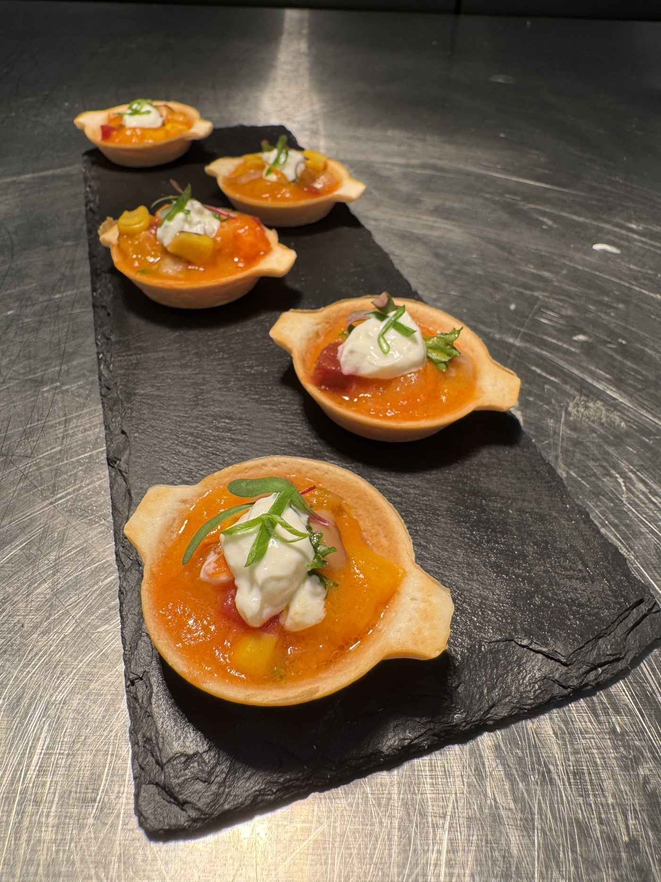
05
Sweet Potato &
Golden Beet Borscht
Ukrainian borscht, gone golden with Southern sweet potato.
ORIGIN Southern / Ukrainian FORMAT Borscht
Roasted sweet potato and golden beet, blended silky — a cool borscht shot with dill and sour cream.

Slide 8
THE SOUTHERN PANTRY
Six Southern ingredients, and where they come from.
Carolina Gold Rice
Andouille Sausage
Sweet Potato
The rice that built the Lowcountry — cultivated on the Carolina coast by enslaved West Africans. Pressed for the musubi.
Smoked pork sausage from Cajun Louisiana, where French cooking met German sausage-craft. Glazed for the musubi.
A cornerstone of the Southern table, deep in African American cooking — from the field to the pie plate. Roasted into the golden beet borscht.
Cornmeal
Catfish
Collard Greens
Ground from the corn the South learned from Native peoples — cornbread, grits, hushpuppies. Griddled into the hoe cake.
A Mississippi Delta and Gulf Coast staple, the heart of the Southern fish fry. Smoked here into a rich rillette.
A cornerstone of African American cooking, simmered low with pot likker. Blanched as a nori substitute in the musubi.

Slide 9
Five bites.
Five traditions.
One Southern soul.
Every bite carries the weight of Southern tradition — the soul stays Southern, the flavors go global.
HL CATERING
hl@hlcatering.com

