Slide 1
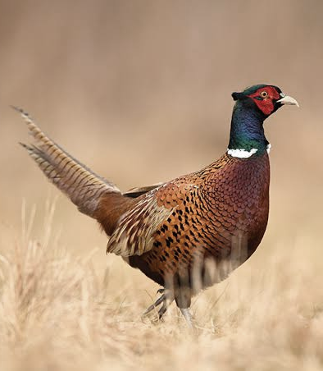

Feather + Field
Modern Butchery & Catering Scalability
Adam Carroll Catering Chef, Bingemans Hospitality inc.
Jeremy Langemann C.C.C. Executive Chef, Bingemans Hospitality inc.
#aocf2026
Notes:
Good afternoon, everyone, and thank you for being here with us at the close of the conference. CONGRATS! YOU MADE IT!
For this final session, We want to finish on something that feels both elegant and applicable: pheasant and foie gras ballotine, a dish that reflects heritage craft, refined presentation, and the kind of structure that matters in modern catering.
As we move through the session, we’ll look at the butchery, the build, and the supporting components that bring the plate together.
My hope is that you leave this afternoon with a few ideas you can carry back into your own kitchens — not only about the dish itself, but about precision, balance, and execution under various service conditions.

Slide 2
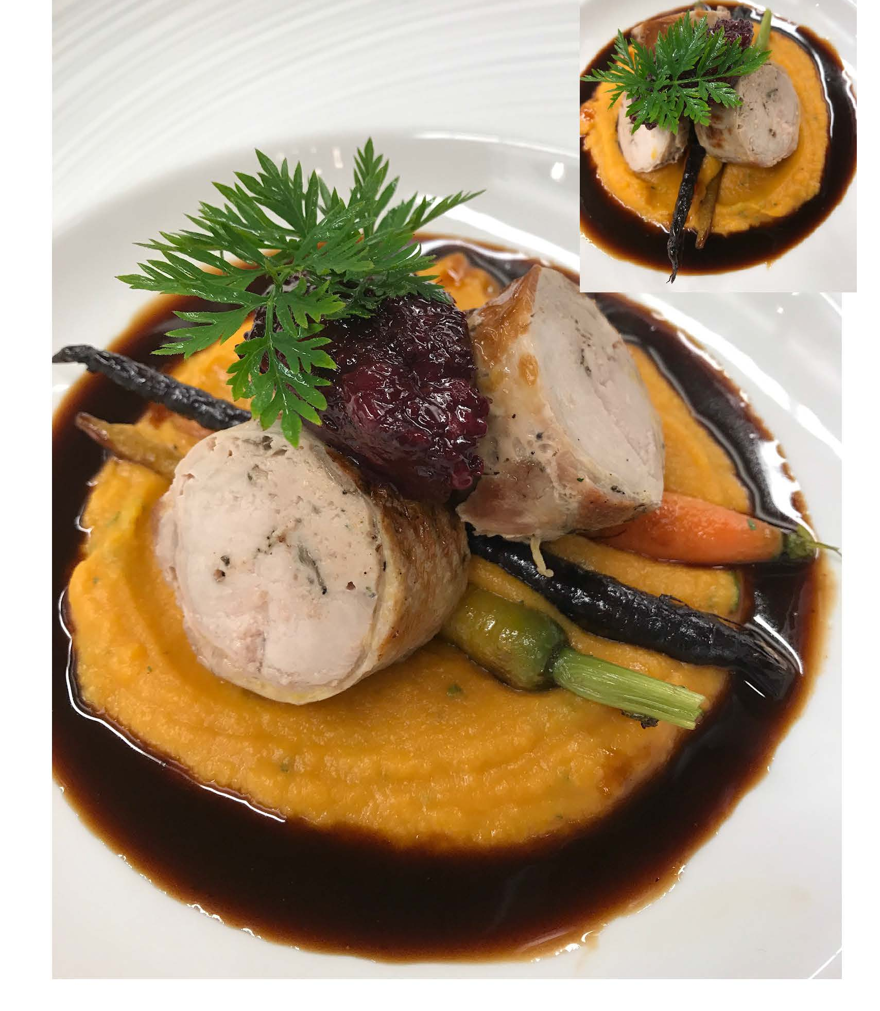
What’s
On the Block Today
Pheasant + Foie Gras Ballotine
sweet potato corn pudding blackberry relish
thyme jus
#aocf2026

Slide 3
Take It Back
Be able to debone + prepare pheasant for ballotine assembly
Understand how to control texture and moisture
Be able to adapt the dish for catering production
#aocf2026
Notes:
should be able to debone and prepare pheasant for ballotine assembly while
protecting the skin
preserving structure
Work through the breakdown with intention
understand how to control texture and moisture
managing fat placement
wrap tension
gentle cooking and resting to promote tenderness and clean slicing, these suckers are lean!
be able to adapt the dish for catering production
prioritizing prep – butchery takes a while, do it early in the process, you don’t want to be rolling the night before the event
hold, and finish stages
support zero-waste, use the whole bird = efficiency and margin control

Slide 4

Thank You!
Adam Carroll, Jeremy Langemann
Kitchener, Ontario, Canada

